Slide 1
University Database Management System

Slide 2
Introduction
The University Database Management System, a platform designed to efficiently organize and manage information related to students, instructors, courses, and departments. This system ensures seamless data integration and retrieval, facilitating streamlined university operations and enhancing overall administrative efficiency.

Slide 3
Name of all tables
Department Table
Student Table
Instructor Table
Course Table

Slide 4
Name of relational tables
Course_taken Table
Course_Conducted Table
Advisor Table

Slide 5
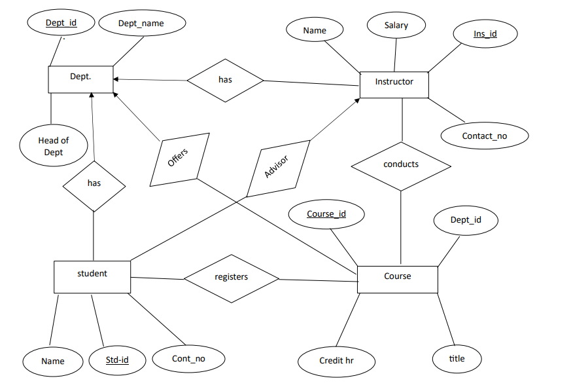
E-R diagram

Slide 6
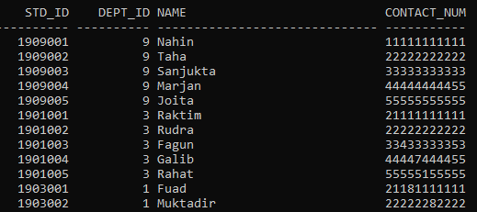
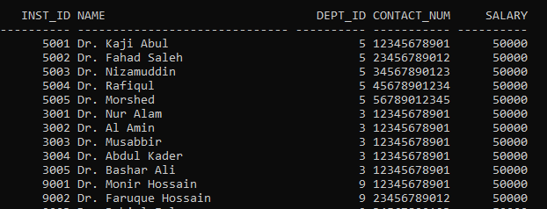
Student & Instructor Table

Slide 7
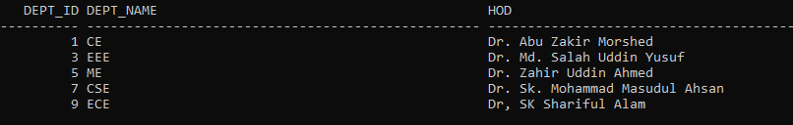
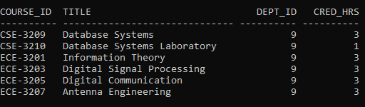
Department & Course Table

Slide 8
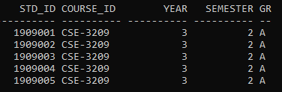
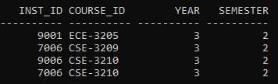
Course Taken Table
Course Conducted Table

Slide 9
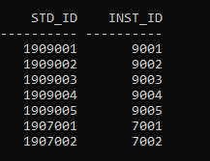
Advisor Table

Slide 10
Thank You

